Slide 1
Text Understanding:
Cg Extensions for SEMANTIC TEXT INTERPRETER
Benjamin Chu Min Xian
15-Oct-2010

Slide 2
Outline
Objective
Introduction
Referent fields
Thematic Roles
Embedded Graph
Negation
Syntactic Parsing
Research Direction
Conclusion

Slide 3
OVERVIEW: motivation
Enhance the current implementation of the semantic text interpreter to improve the accuracy of the generated conceptual graphs
There are a few aspects to be considered to improve the current accuracy of how the conceptual graph is being represented: thematic roles, embedded graph, negation, referent fields and alternative syntactic parsers.

Slide 4
Introduction
Enhance the current CG rules for Semantic Text Interpreter
Embedded Graph
Referent Fields
Thematic Roles
Negation
Alternative syntactic parsers

Slide 5
Referent field
1. For the linear graph notation, concept box is normally separated by a colon with the
type field on the left and the referent field on the right.
The referent field can be a name, for e.g. [cat: yojo]
Kind of referent | Example | How it is read
Universal | [cat: V] | Every cat
Singular | [cat: @1] | Exactly one cat
Generic Set | [cat: {*}] | Cats
Counted Set | [cat: {*}@3] | Three cats
Set of individuals | [cat: {yojo, bell}] | Yojo and Bell
List of individuals | [cat: <yojo, bell>] | Yojo and then Bell
Partial set of individuals | [cat: {yojo, bell, *}] | Yojo, Bell and others
Question | [cat: ?] | Which cat?
Plural question | [cat: {*}?] | Which cats?
Measure | [interval: @5sec] | Interval of 5 seconds

Slide 6
Referent field
2. In CG notation, there are 6 types of referent fields:
Which can be used with concept types person and all of its subtypes
e.g. [person:john]<-(agnt)<-[go]
Referent types
Individual
Generic
Universal
Null
Collective Set
Disjunctive Set
Names
Measures
Which can be used with concept type measure and all of its subtypes
e.g.
[person]<-(agnt)<-[has]-{
(chrc)->[height]->(meas)->[measure: 172cm];
}.
Or in the contracted form,
[person]<-(agnt)<-[has]-{
(chrc)->[height:@172cm];
}.

Slide 7
Referent field
2. In CG notation, there are 6 types of referent fields:
Which can be used with concepts that are not measureable.
e.g.
[person:#7281]->(name)->[“john"]
if abbreviated: [person:john]
Referent types
Individual
Generic
Universal
Null
Collective Set
Disjunctive Set
Individual markers

Slide 8
Referent field
2. In CG notation, there are 6 types of referent fields:
Which can be used with concepts that are not measureable.
e.g.
[person:#7281]->(name)->[“john"]
if abbreviated: [person:john]
Referent types
Individual
Generic
Universal
Null
Collective Set
Disjunctive Set
Individual markers

Slide 9
Referent field
2. In CG notation, there are 6 types of referent fields:
Referent types
Individual
Generic
Universal
Null
Collective Set
Disjunctive Set
Which can be used with any concept, and is default if no referent is present in a concept.
e.g.
[person:*]<-(agnt)<-[build]->(rslt)-> [tree-house].
A generic marker can be restricted to a type consistent individual referent which can be: name, measure or individual marker.

Slide 10
Referent field
2. In CG notation, there are 6 types of referent fields:
Referent types
Individual
Generic
Universal
Null
Collective Set
Disjunctive Set
Which can be used with any concept. A universal quantifier means that all individual concepts of a specific type have properties described by the graph.
e.g.
[cat:V]<-(agnt)<-[has]->(thme)->[tail:@1].
Every cat has exactly one tail.
A universal quantifier can be restricted to a generic marker or to a type of consistent individual referent which can be: name, measure or individual marker.

Slide 11
Referent field
2. In CG notation, there are 6 types of referent fields:
Referent types
Individual
Generic
Universal
Null
Collective Set
Disjunctive Set
Which can be used with any concept. It is mainly used to define optionality when included into a disjunctive set referent.
e.g.
[person:*]<-(name)<-[word:* | null].
There is a person with an optional name.

Slide 12
Referent field
2. In CG notation, there are 6 types of referent fields:
Aggregation and Individuation
A collective set - all elements of a set participate in some relationship together.
Example: Conceptual graphs with collective set as referent
[person:liz] <- (agnt) <- [travel]
[person:kirby] <- (agnt) <- [travel]
[person: {liz,kirby}] <- (agnt) <- [travel]
A disjunctive set - one element of the set is the actual referent at any particular time.
[elephant:clyde]<-(agnt)<-[live]-{
(loc)->[continent: africa]->(or)->[continent: asia];
}.
[elephant:clyde]<-(agnt)<-[live]-{
(loc)->[continent: {africa | asia}];
}.
Referent types
Individual
Generic
Universal
Null
Aggregation & Individuation

Slide 13
Referent field
2. In CG notation, there are 6 types of referent fields:
Aggregation and Individuation
A distributive set - Each element of a set satisfies some relation, but they do so separately.
Example: Conceptual graphs with distributive set as referent
[person:dist{betty,jerry}] <- (agnt) <- [laugh]
A respective set - Each element of an ordered sequence bears a particular relationship to a corresponding element of another sequence.
Example: Conceptual Graph with respective set as referent.
[male-person:resp{john,jack}] <- (agnt)<- [study] -> (thme) -> [course:resp{aic225,aic227}]
Referent types
Individual
Generic
Universal
Null
Aggregation & Individuation

Slide 14
Thematic Role
1. Differentiate between because and purpose
Bill is wet because it is raining.
[situation: [male-person: bill]<-(ptnt)<-[wet]]->(bcas)->[situation: [rain]]
Bill travelled to Jeff-Davis-Peak because he wants to scale the
mountain.
[male-person: bill]<-(agnt)<-[travel]-{
(dest)->[mountain: jeff-davis-peak];
(purpose)->[want]-{
(expr)->[he];
(theme)->[scale]->(thme)->[mountain];
}
}.

Slide 15
Thematic Role
Because; Bcas(Situation, Situation).
A situation in the role of causing another situation. A cause is correlative to an effect.
Example:
i) Bill is wet because it is raining.
subj v-ch main pm subj v-ch cnt
ii) Bill travelled to Jeff-Davis-Peak because he wants to scale the mountain.
subj main goa pcomp pm subj cnt pm obj det obj
cnt=contingency (purpose or reason)
pm=preposed marker

Slide 16
Thematic Role
Because; Bcas(Situation, Situation).
A situation in the role of causing another situation. A cause is correlative to an effect.
Example:
i) Bill is wet because it is raining.
subj v-ch main pm subj v-ch cnt
ii) Bill travelled to Jeff-Davis-Peak because he wants to scale the mountain.
subj main goa pcomp pm subj cnt pm obj det obj
Although technically it is a subject of the verb, it is considered as a dummy subject
pm=preposed marker

Slide 17
Thematic Role
Using verb valency to resolve:
What is verb valency?
verb valency or valence refers to the number of arguments controlled by a verbal predicate
There are several types of valency:
an avalent verb takes no arguments, e.g. It rains. (Though it is technically the subject of the verb in English, it is only a dummy subject)
a monovalent verb takes one argument, e.g. He sleeps.
a divalent verb takes two, e.g. He kicks the ball.
a trivalent verb takes three, e.g. He gives her a flower.

Slide 18
Thematic Role
Because; Bcas(Situation, Situation).
A situation in the role of causing another situation. A cause is correlative to an effect.
Example:
i) Bill is wet because it is raining.
subj v-ch main pm subj v-ch cnt
ii) Bill travelled to Jeff-Davis-Peak because he wants to scale the mountain.
subj main goa pcomp pm subj cnt pm obj det obj
Verb valency=1 (monovalent)
Verb valency=3 (trivalent)

Slide 19
Thematic Role
If verb , then assign to bcas thematic role.
Else if verb , then assign to purpose thematic role
Use preposed marker(pm) to break down the sentence into phrases, where the phrases can be situational.
More examples:
Bill was late because his car crashed into the wall.
[male-person: bill]<-(agnt)<-[late]-{
(bcas)->[situation: [car]<-(efct)<-[crash]->(ptnt)->[wall]];
}.
Bill was late because he needs to repair his car.
[male-person: bill]<-(agnt)<-[late]-{
(purpose)->[need]-{
(agnt)->[he];
(thme)->[repair]->(thme)->[car]->(poss)->[he];
}.
valency <=2
valency > 2
Alternative: use schema graphs to differentiate bcas and purpose

Slide 20
Thematic Role
2. Differentiate between base and agnt
Base(Attribute, Type).
A type of role that determines how an attribute is related to its object.
Example:
Joshua Bell is an American Grammy Award-winning violinist.
Previous:
[male-person: joshua-bell]<-(agnt)<-[be]-{
(thme)->[violinist]->(attr)->[american-grammy-award-winning];
}.
Current:
[male-person: joshua-bell]<-(attr)<-[american-grammy-award-winning]<-(base)<-[violinist].

Slide 21
Thematic Role
3. Using comparand relation type
Comp(Attribute, Type).
An object that serves as a standard of comparison for some attribute.
An object being compared is correlative to another object.
Example:
Bill is taller than Jack
@PCOMPL-S %NH A CMP
It is difficult to check through syntactic analysis, but there is useful morphological
information about comparatives.
A |  | Adjective | Example
--comparison | ABS | Absolutive | Tall
 | CMP | Comparative | Taller
 | SUP | Superlative | Tallest

Slide 22
Thematic Role
3. Using comparand relation type
a) Bill is taller than Jack
Previous:
[male-person: bill]<-(agnt)<-[be]-{
(attr)->[tall];
(rcpt)->[male-person: jack];
}.
Current:
[male-person: bill]<-(attr)<-[tall]<-(comp)<-[male-person: jack].
Bill and Bob are taller than Jack
Previous:
[male-person: bill]<-(and)<-[male-person: bob] <-(attr)<-[tall]<-(comp)<-[male-person: jack].
Current:
[male-person: {bill, bob}]<-(attr)<-[tall]<-(comp)<-[male-person: jack].

Slide 23
Thematic Role
4. Using BFOR and SUCC relation type
BFOR= An occurrent that occurs before some other occurrent.
SUCC=An occurrent that occurs after some other occurrent.
A successor is correlative to a predecessor.
a) John ate an apple before going to school.
[situation:[male-person: john]<-(agnt)<-[eat]->(thme)->[apple]]->(bfor)->
[situation:[male-person: john]<-(agnt)<-[go]->(dest)->[school]].
b) After Bill ate the pretzel, he drank some beer.
[situation: [male-person: bill *x]<-(agnt)<-[eat]->(thme)->[pretzel: #]]- (succ)->[situation: [?x]<-(agnt)<-[drink]->(thme)->[beer]].

Slide 24
Embedded GRAPH
Use the concept type PROPOSITION
Sentence:
Mary thinks that John drove to London during the weekend.
Graph:
[female-person: mary] <-(expr)<-[think]-{
(thme)->[PROPOSITION: [male-person: john]<-(agnt)<-[drive]-{
(dest)->[european-city: london];
(ptim)->[weekend];
}]
} .

Slide 25
Embedded GRAPH
Sentence:
Mary thinks that John drove to London during the weekend.
FDG Syntax:
#Text Baseform Syntactic relation Syntax and morphology
1 Mary mary subj:>2 @SUBJ %NH N NOM SG
2 thinks think main:>0 @+FMAINV %VA V PRES SG3
3 that that
4 John john attr:>5 @A> %>N N NOM SG
5 drove drive @OBJ %NH N NOM SG
6 to to mod:>5 @<NOM %N< PREP
7 London london pcomp:>6 @<P %NH N NOM SG
8 during during mod:>7 @<NOM %N< PREP
9 the the det:>10 @DN> %>N DET
10 weekend weekend pcomp:>8 @<P %NH N NOM SG
11 <s> <s>
Missing?
@CS %CS CS
Subordinating conjunction
Missing?

Slide 26
Embedded GRAPH
Subordinating conjunction:
The majority of conjunctions are "subordinating conjunctions". Common subordinating conjunctions are:
after, although, as, because, before, how, if, once, since, than, that, though, till, until, when, where, whether, while
Example:
Main or independent clause | Subordinate or dependent clause
John went swimming | although | it was raining.
 | Subordinating conjunction

Slide 27
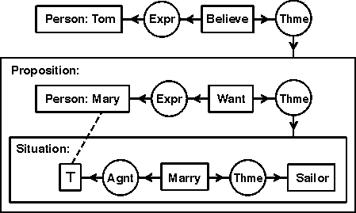
Embedded GRAPH
Question:
Is every graph situational?
When situation can be applied?
2. Use the concept type SITUATION
Sentence:
Tom believes that Mary wants to marry a sailor.

Slide 28
Negation
There is syntactic information can be used for negation for the word ‘not’
1 2 3 4 5 6 7 8
i) John did not go to London by bus
Syn rel: subj:>2 v-ch:>4 neg:>2 main:>0 goa:>4 pcomp:>5 ins:>4 pcomp:>7
Negation:
(not) -> {
[male-person: john]<-(agnt)<-[go]->(dest)->[european-city: london];
}.
1 2 3 4
ii) John has no car
Syn rel: subj:>2 main:>0 det:>4 obj:>7
Negation:
(not) -> {
[male-person: john]<-(agnt)<-[has]->(thme)->[european-city: car];
}.
Question:
How can we address
for this case to
generate a negated
graph?
There is no syntactic information can be used for negation; so how can this form a negated graph?

Slide 29
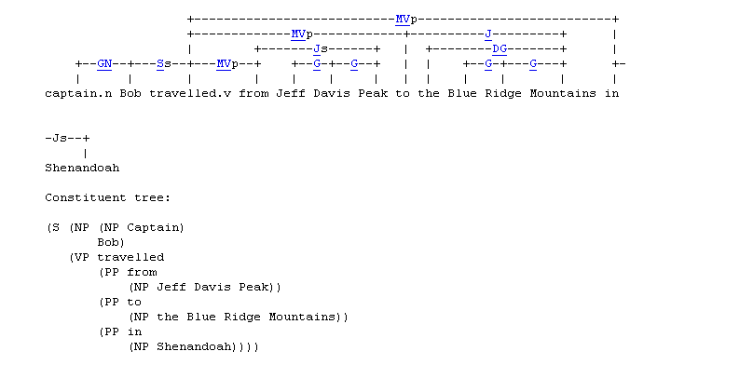
SYNTACTIC PARSING
Link Grammar Parser
syntactic parser of English, based on link grammar, an original theory of English syntax
Given a sentence, the system assigns to it a syntactic structure, which consists of a set of labeled links connecting pairs of words.
E.g.
Captain Bob travelled from Jeff Davis Peak to the Blue Ridge Mountains
in Shenandoah.

Slide 30
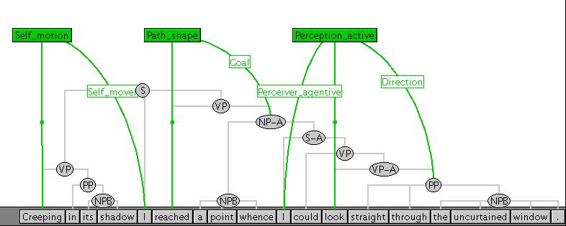
SYNTACTIC PARSING
Shalmaneser: A Shallow Semantic Parser
supervised learning toolbox for shallow semantic parsing
automatic assignment of semantic classes and roles to text
E.g:
Creeping in its shadow, I reached a point whence I could look straight through the
uncurtained window.

Slide 31
RESEARCH DIRECTION
Thematic Roles
Embedded Graph
Referent Fields
Negated Graph
Alternative Syntactic Parsers

Slide 32
CONCLUSION
The accuracy of the generated conceptual graph is improved when all these aspects: referent fields, thematic roles, embedded graph and negation are incorporated.
For FDG syntax structure, need to improve the rule not to depend alone on the syntactic relation sequence
This is because at times syntactic relation information is incomplete when there is a case of ungrammatical sentence
Alternatively, rules for Link Grammar Parser or Shalmaneser can be considered to enhance the existing FDG syntactical processing rules.

